Slide 1
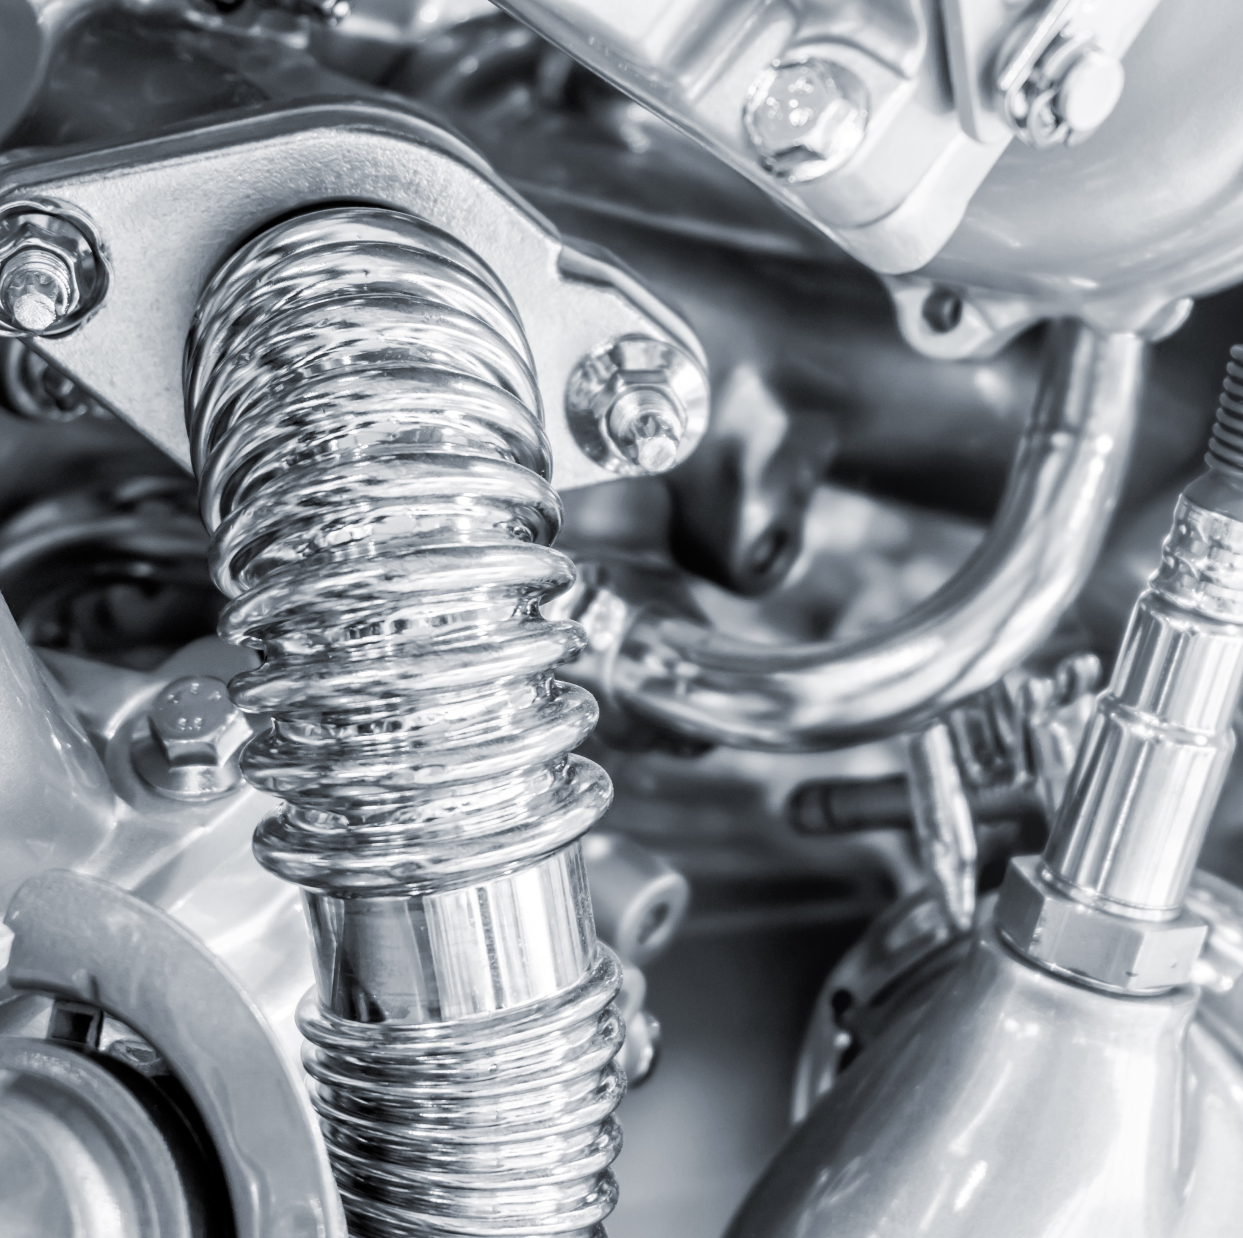
Rover Parts
Mission to Mars

Slide 2
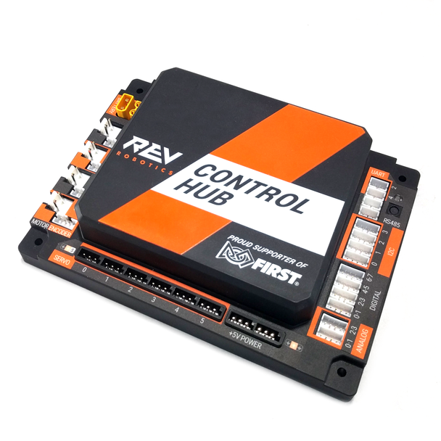
Control Hub
Acts as the robot's central computer
Combines Android processor + Expansion Hub in one unit
Runs the FTC Robot Controller App (on-board)
Connects directly to:
Motors and servos (via motor ports and servo ports)
Sensors (via I2C, analog, and digital ports)
Driver Station (via built-in Wi-Fi Direct or Ethernet)
Powered by a 12V battery
Features USB ports for webcams, gamepads, or extra sensors

Slide 3
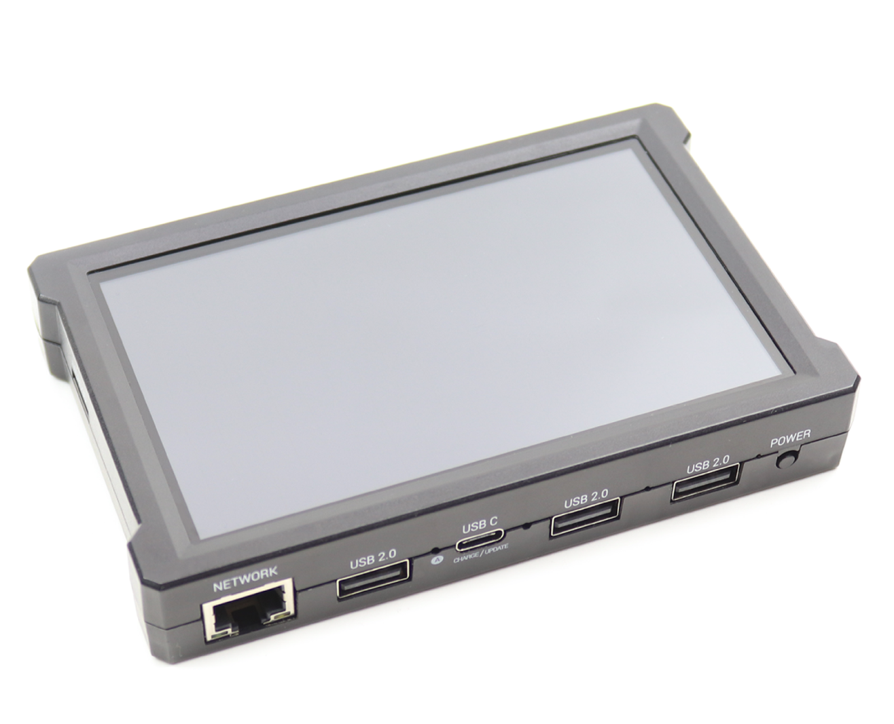
Driver Hub
Acts as the interface for the drive team
Runs the FTC Driver Station App
Connects wirelessly to the Control Hub (via Wi-Fi Direct)
Includes built-in gamepad ports (USB-A) for controllers
Features:
5" touchscreen display
USB and Ethernet ports
Onboard Wi-Fi and Bluetooth
Battery-powered with internal rechargeable battery

Slide 4
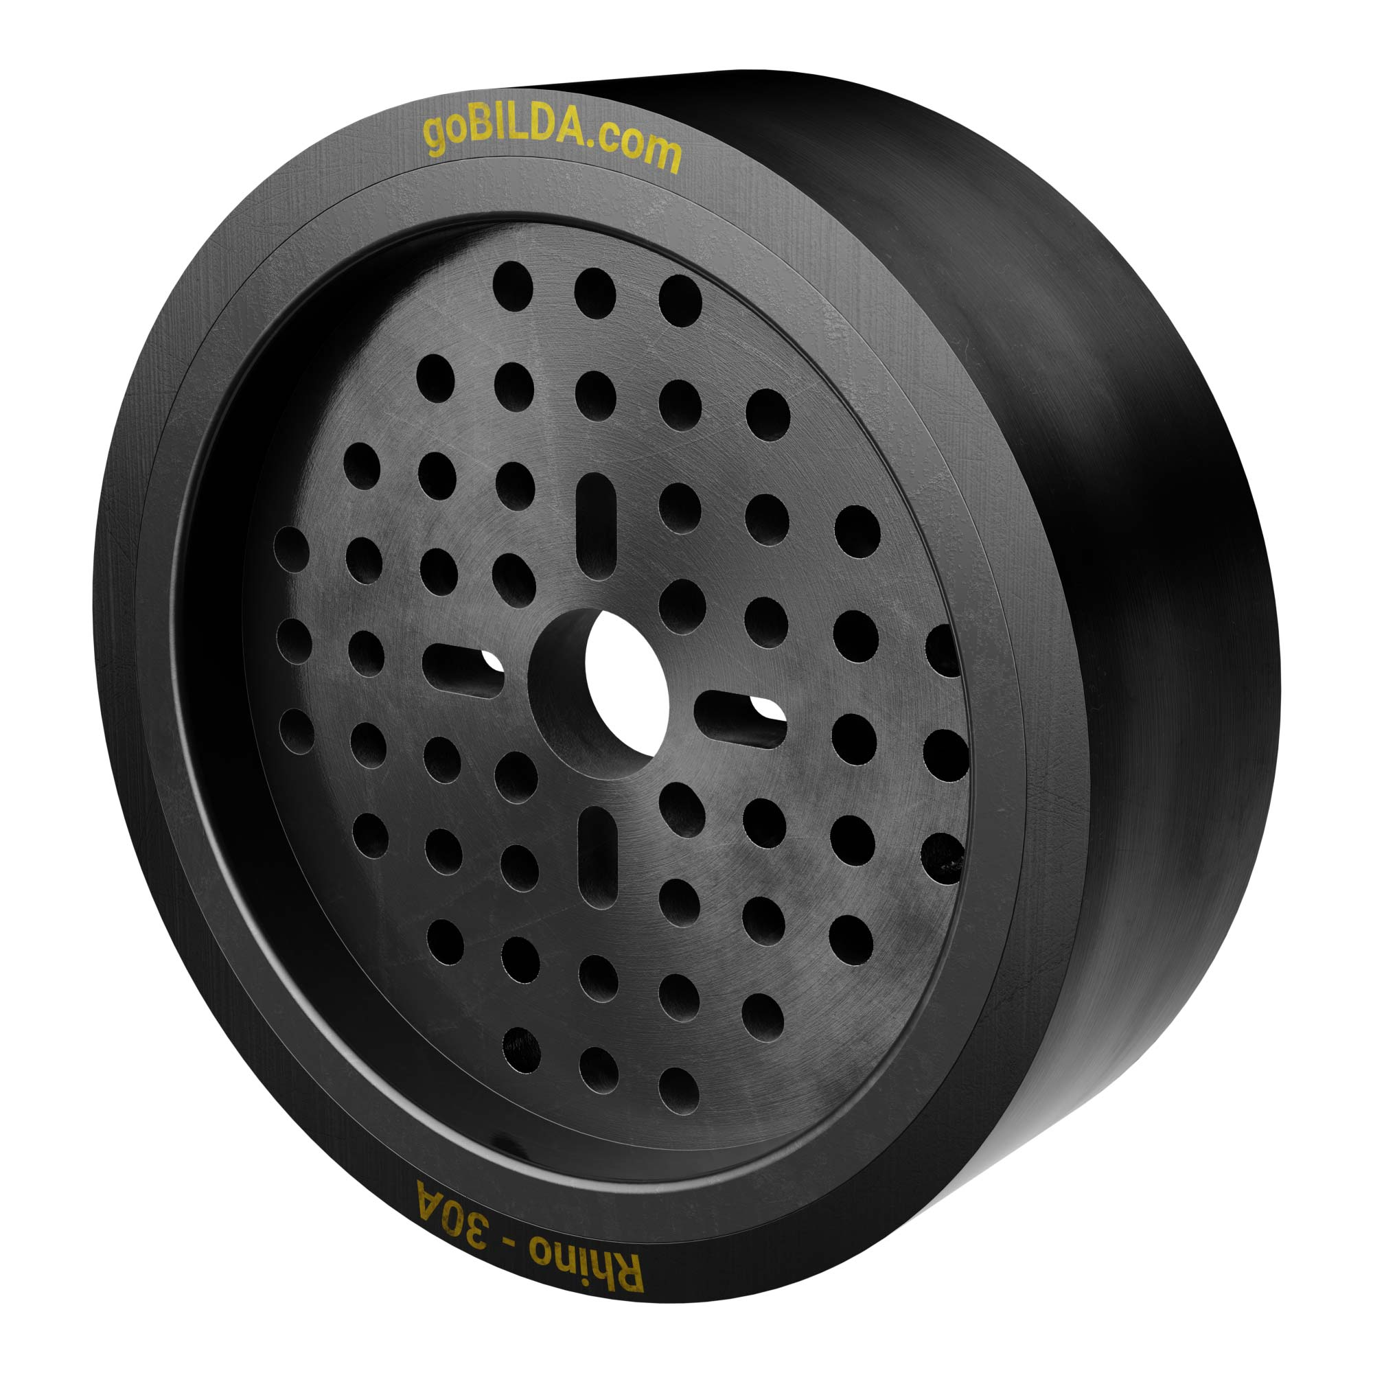
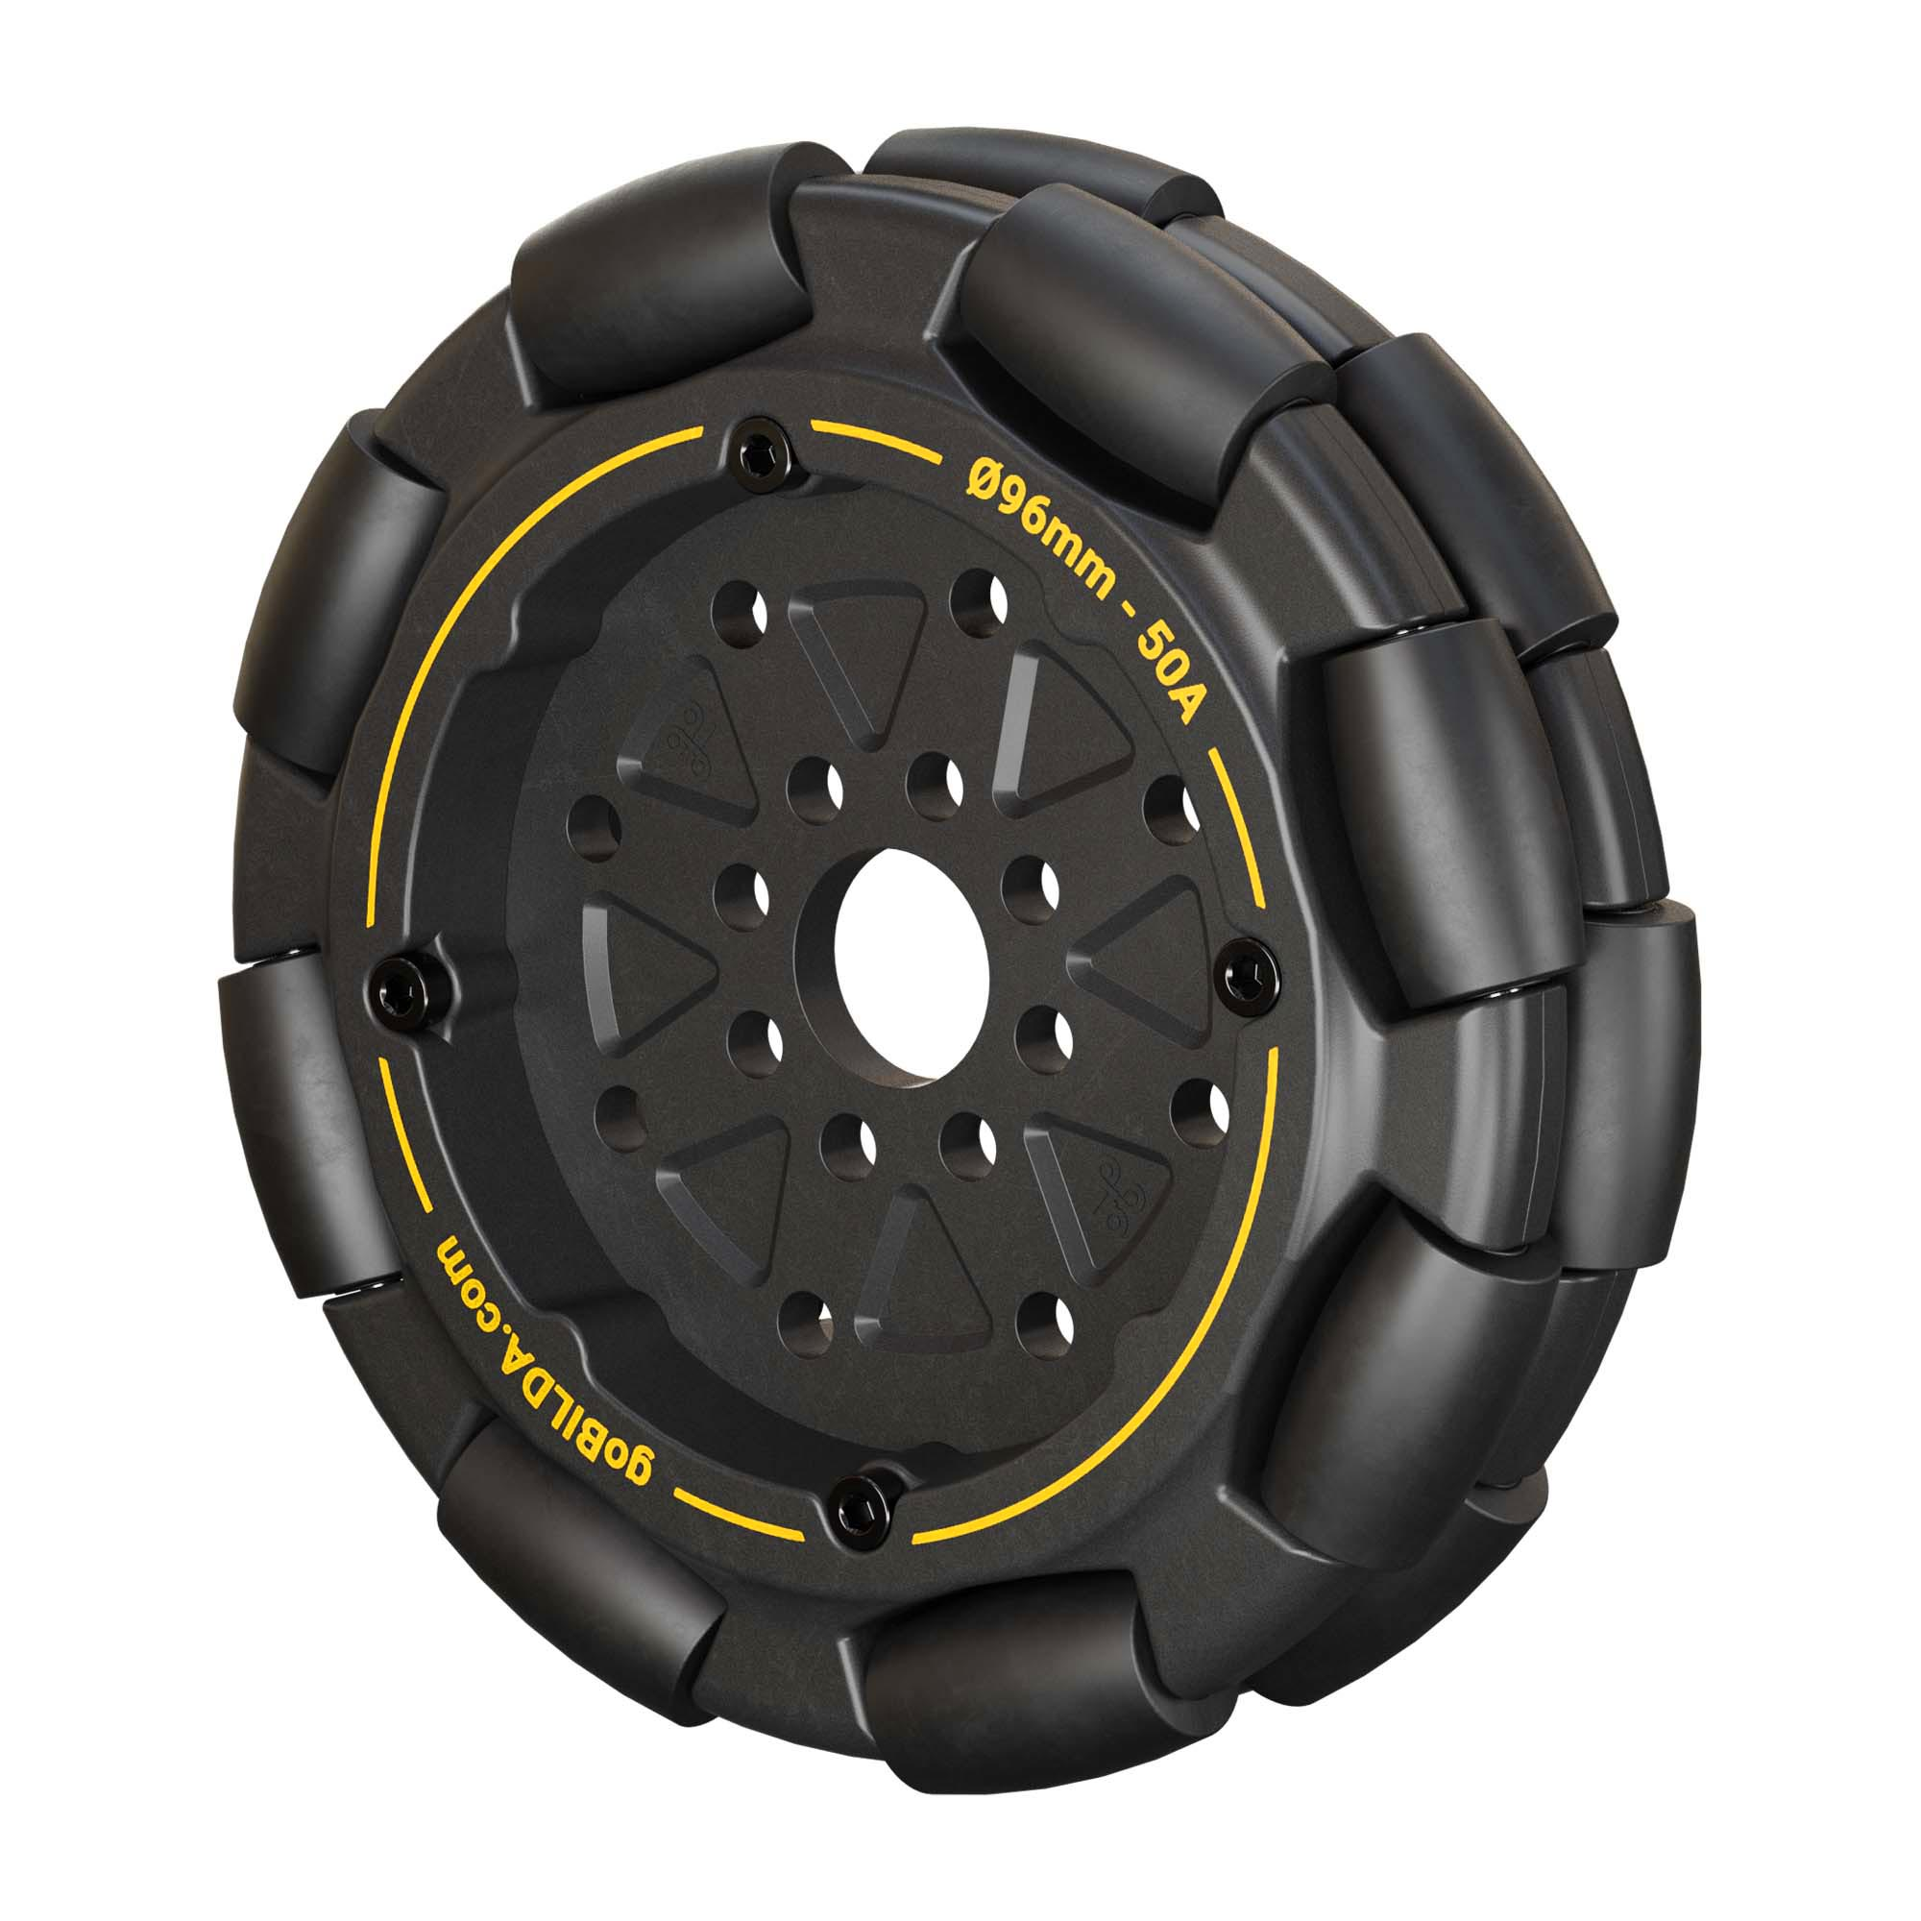
Rhino Wheels
High-traction rubber tank-style tread
Designed for maximum grip on smooth and rough surfaces
Omni Wheels
Feature rollers mounted around the wheel
Allow smooth movement in sideway direction
Excellent for turning and strafing
Often used in holonomic drivetrains

Slide 5
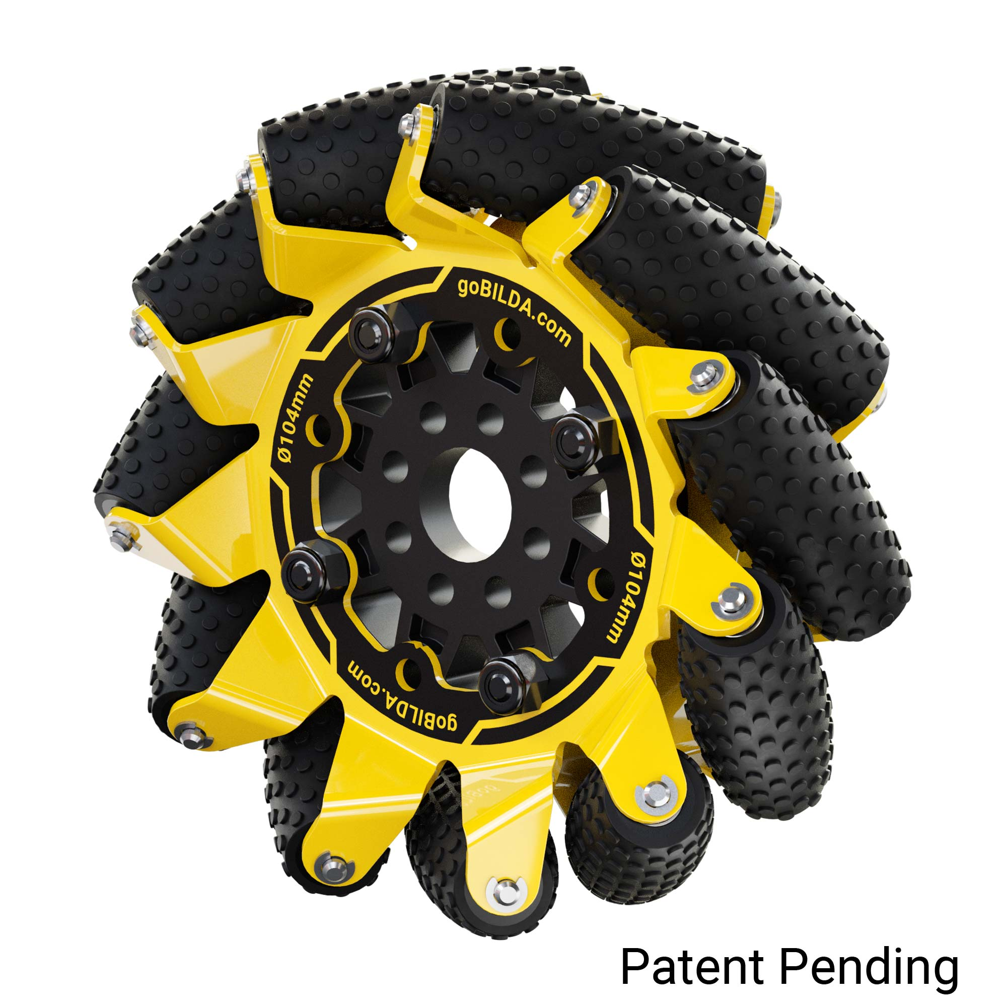
Mecanum Wheels
Enable omnidirectional movement (forward, backward, sideways, diagonal)
Use angled rollers (45°) to redirect force during wheel rotation
Used in Mecanum drive trains for precise, agile control
Require 4 wheels in a specific configuration (mirrored front/rear)
Allow strafe movement without turning the robot
Work best on flat, smooth surfaces

Slide 6
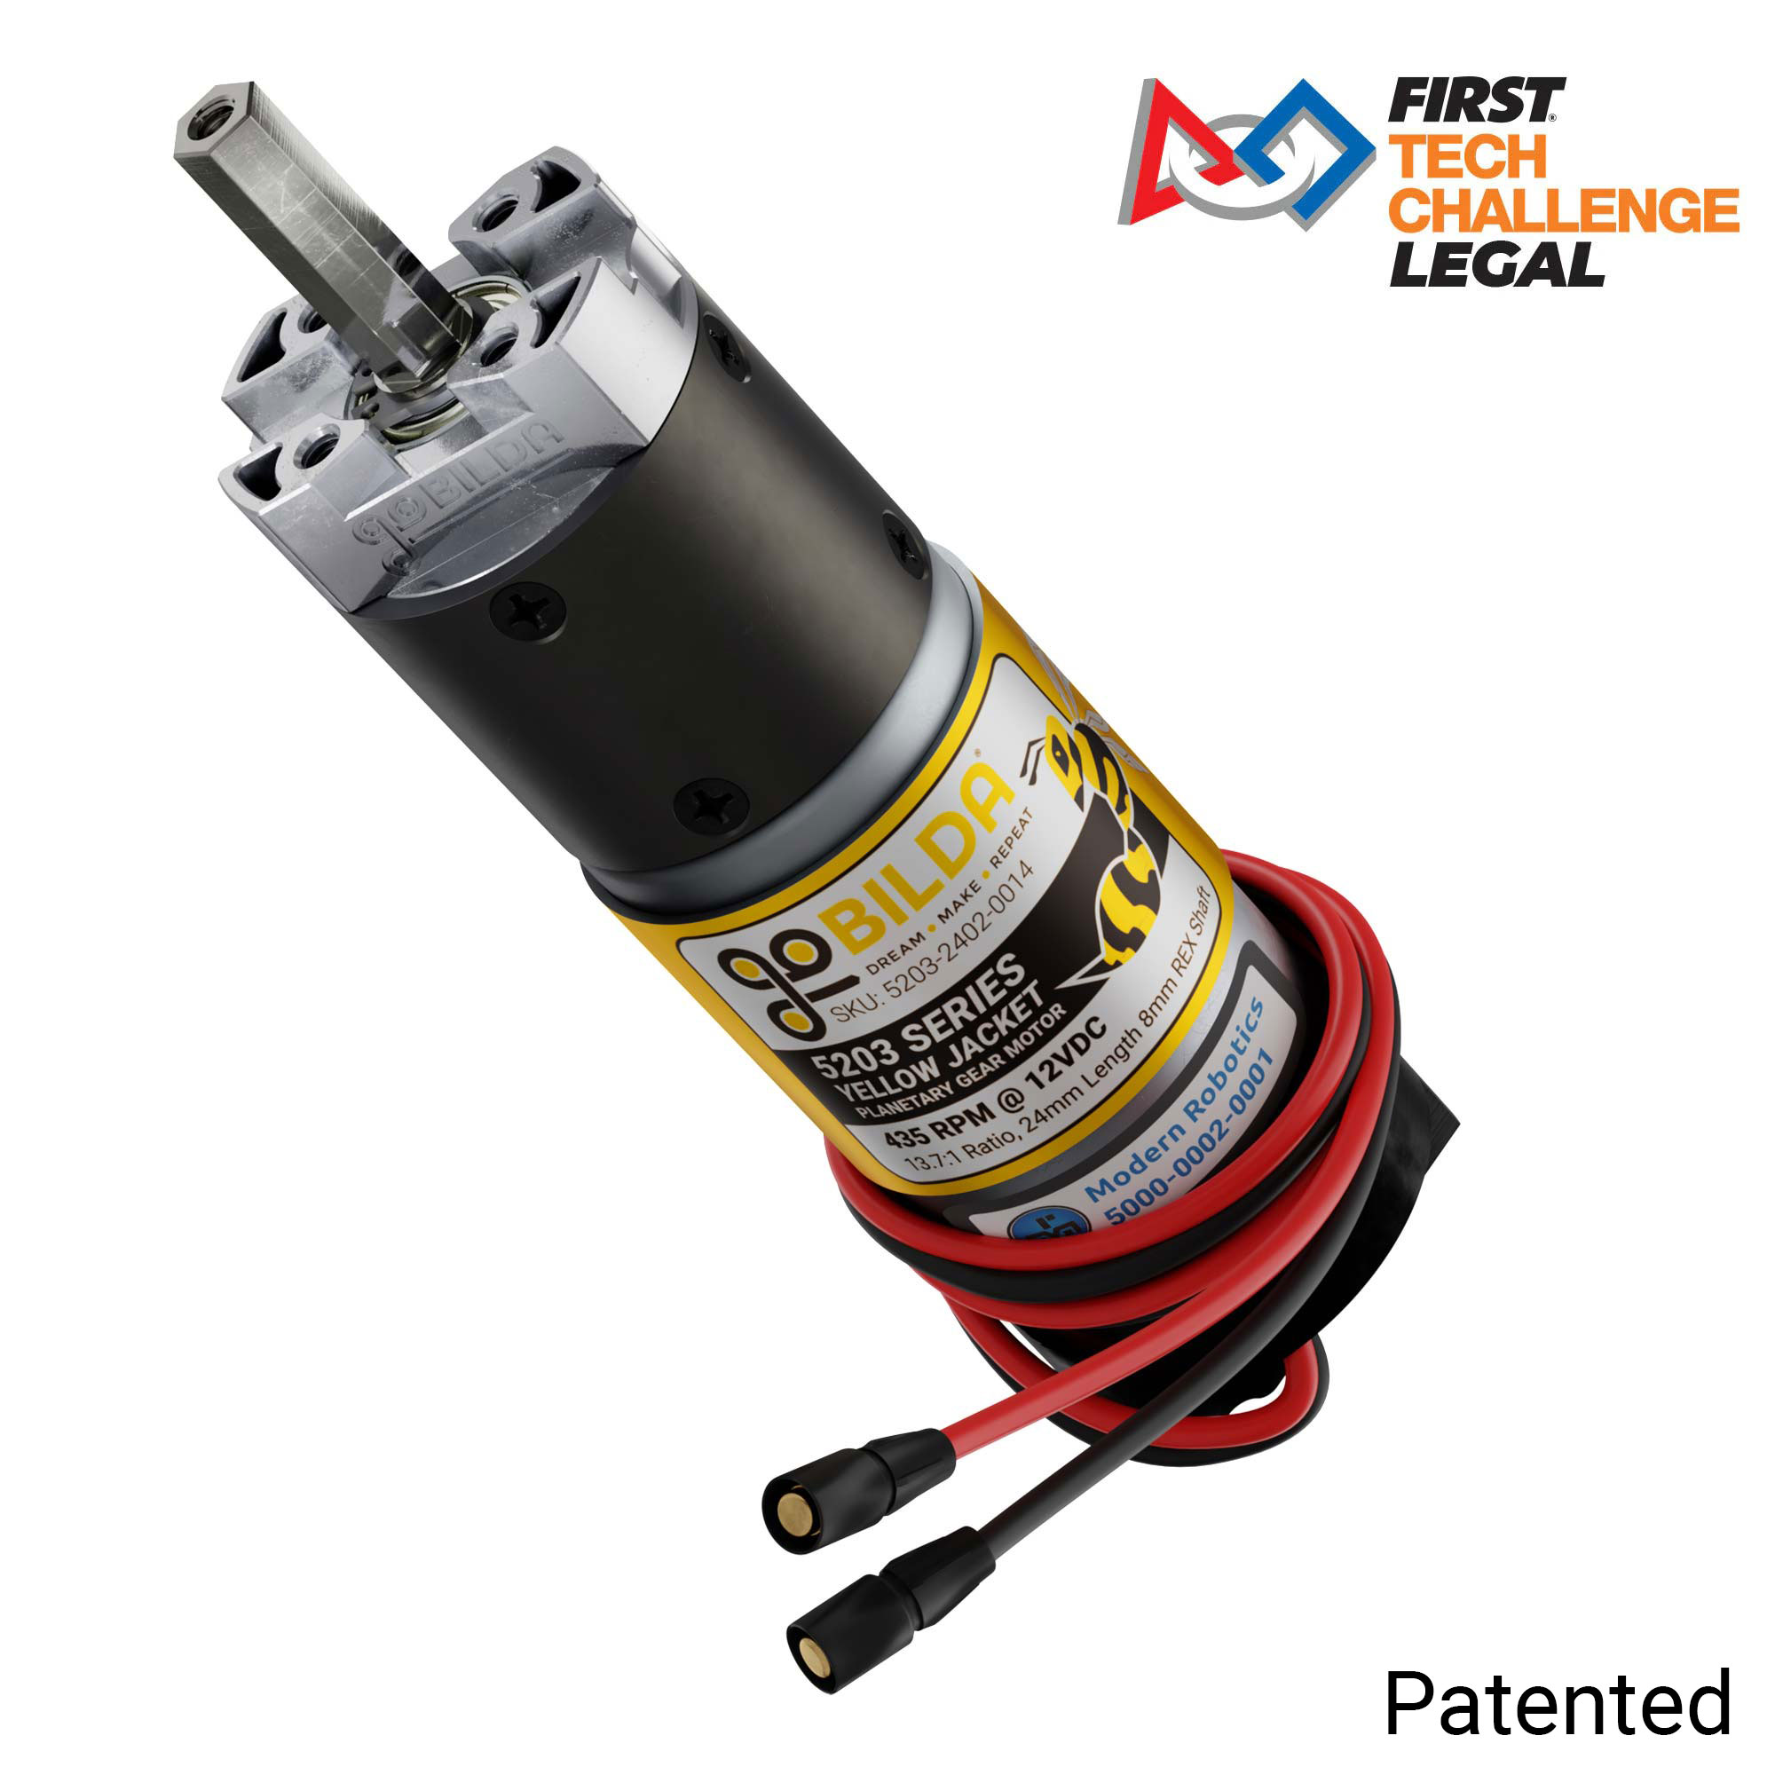
Motors
Motors are the muscles of a robot​
Convert electrical energy → mechanical motion​
Essential for drive trains, arms, lifts, and more
We will be working with the GoBilda 5-Series Motors

Slide 7
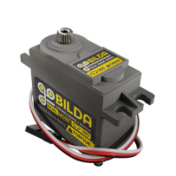
Servos
A servo is a motor with built-in feedback for precise position control
Moves to and holds specific angles (e.g., 0° to 180°)
Controlled by setting a position value, not speed or power
Ideal for claws, arms, gates, and linear actuators

Slide 8
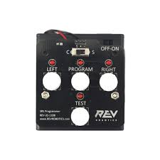
Servo Programmer
Used to configure the servo
Servo or Continuous Rotation mode
Start and end positions

Slide 9
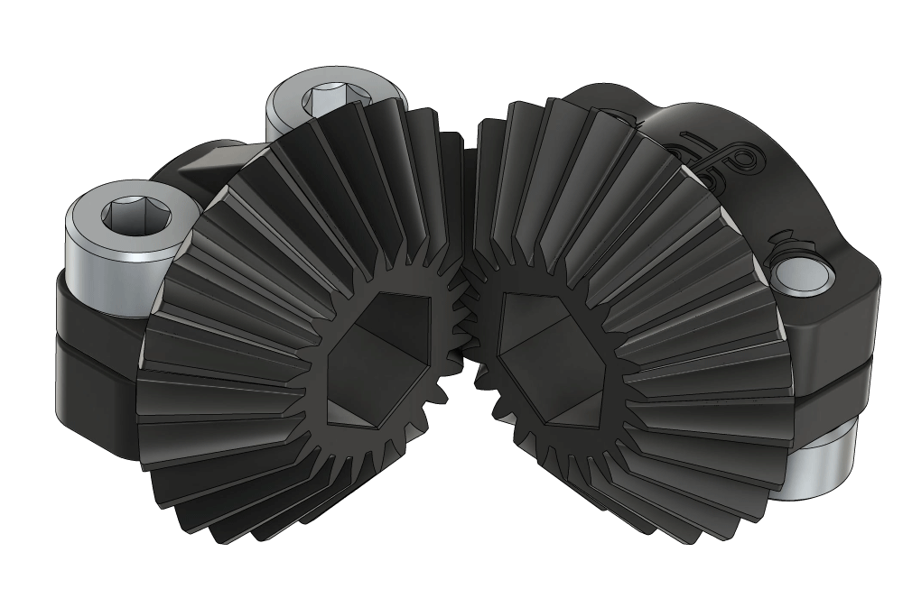
Miter Gears
A type of bevel gear with a 1:1 gear ratio
Transfers motion at a 90° angle between shafts
Ideal for changing rotation direction in compact spaces
Used in our drivetrains

Slide 10
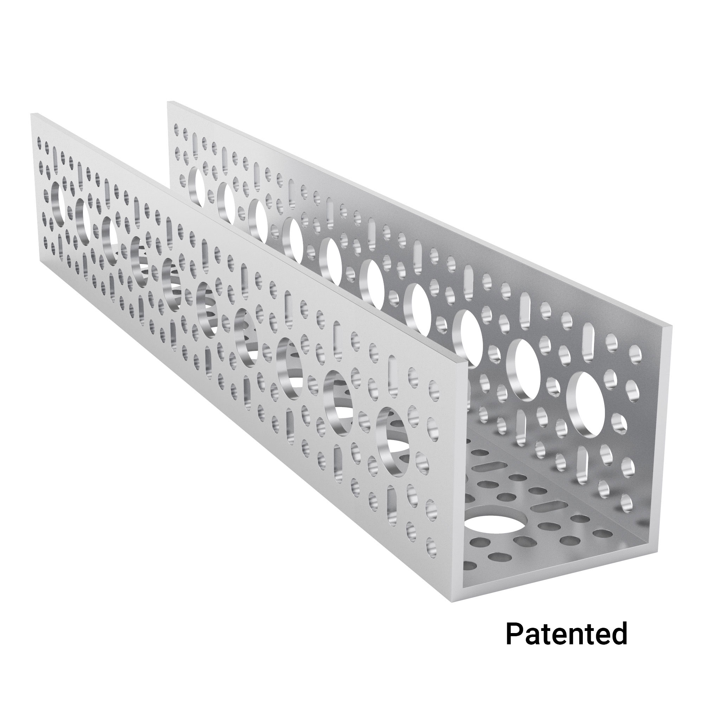
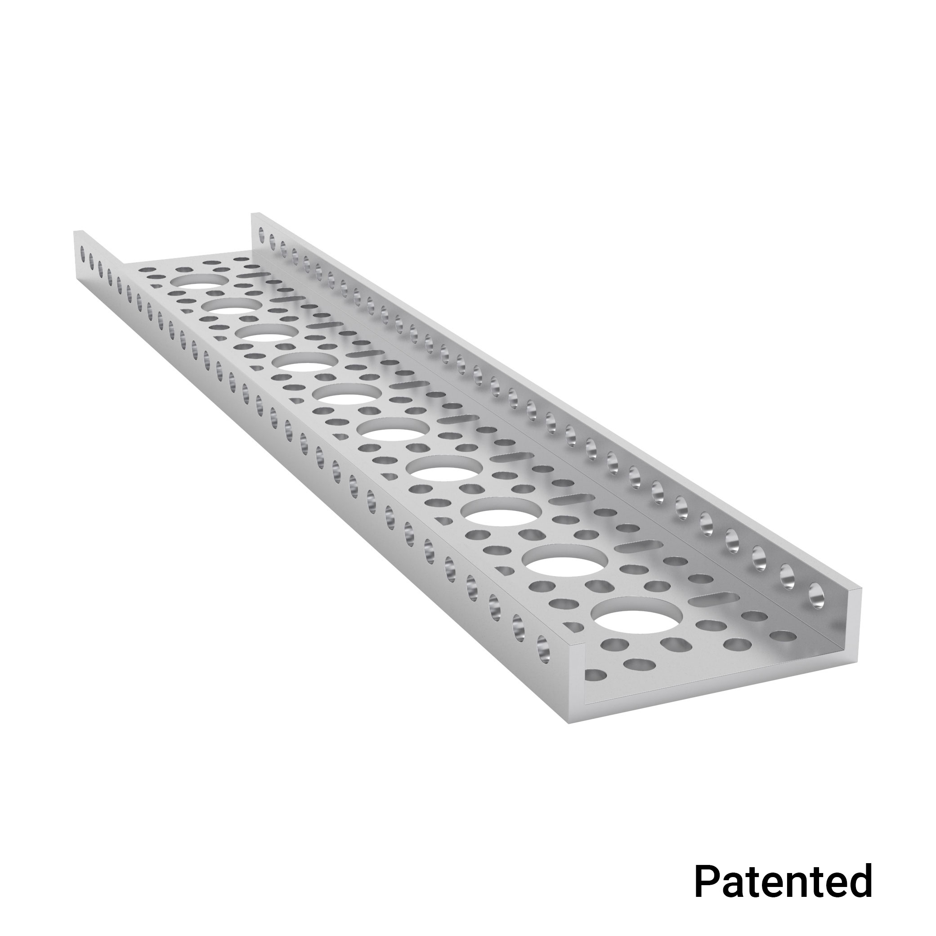
U-Channels
Primary structural building blocks for FTC robots
Feature a U-shaped cross-section for strength and versatility
Made of aluminum – lightweight yet durable
Pre-drilled with 16mm grid pattern for easy mounting
Support modular construction – attach motors, gears, wheels, etc.

Slide 11
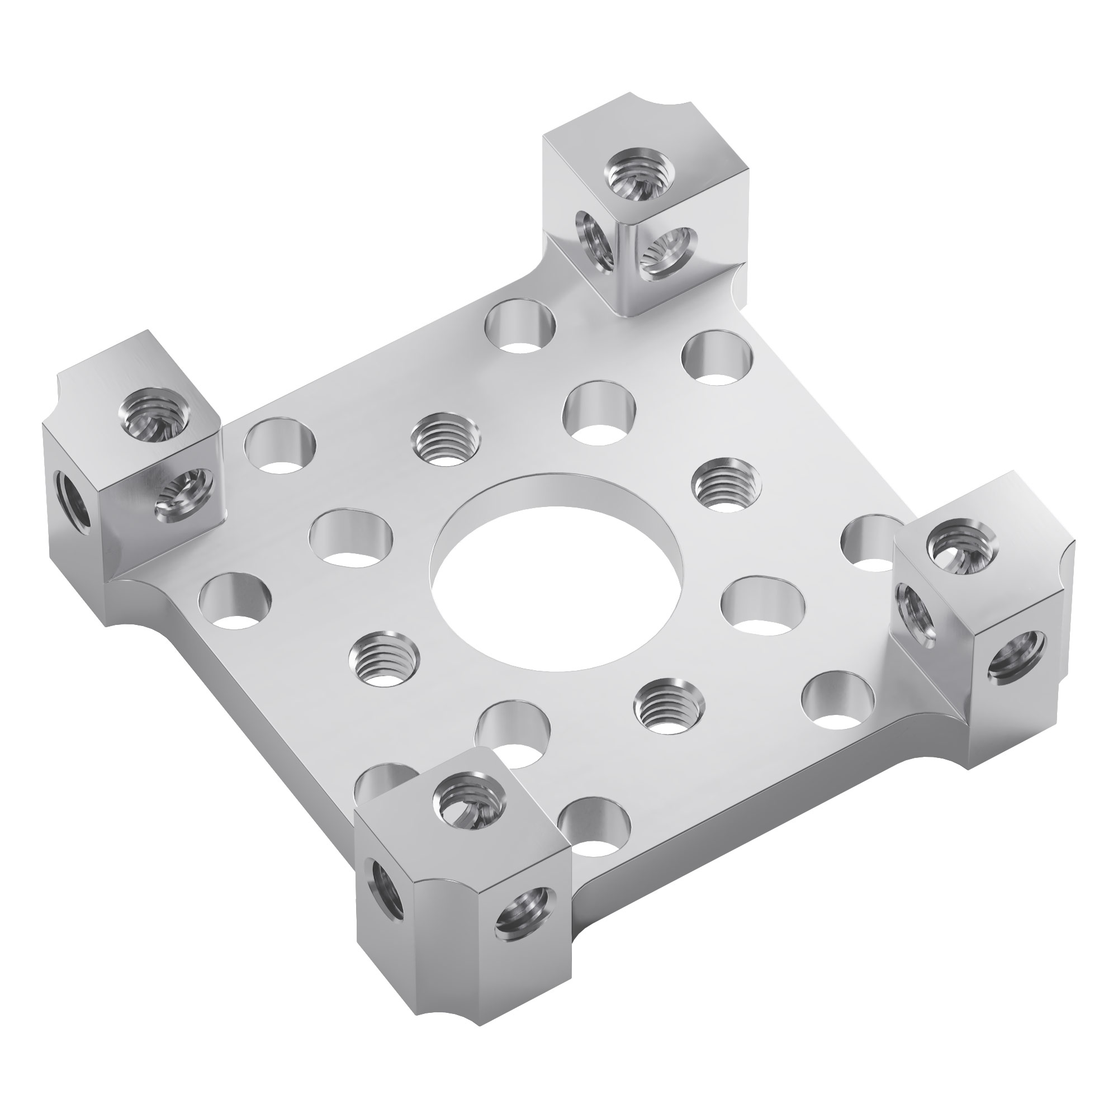
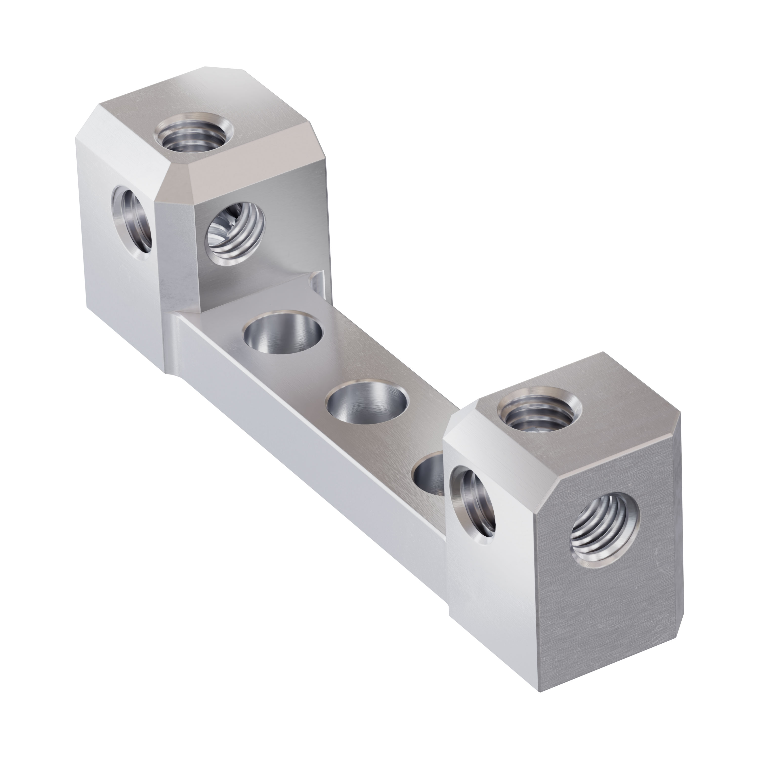
Blocks Mounts
Used to secure motors, bearings, and shafts to structure
Made of machined aluminum – strong, lightweight, and precise

